Slide 1
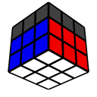
Solving the Cube – Pt. 2
Michael George
WCA ID: 2015GEOR02

Slide 2
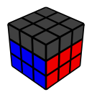
First 2 Layers (F2L)
Approach
Solve F2L corner + edge “pairs” in any order
Note: This differs from “Layer-by-Layer” methods which solve 4 corners then 4 edges
Use short sequences of moves consisting of R U L moves and rotations around the y-axis
Use a simple right-handed “trigger” and its left-handed “mirror” to complete the F2L
Benefits
The right-handed “trigger” and its left-handed “mirror” are easy to understand
Solving F2L “pairs” rather than “layers” will improve piece “recognition”
It will be possible to improve / optimise your F2L skills with additional “algorithms”
Manipulation of F2L “pairs” will be the approach used to solve the last layer

Slide 3

Terminology
Slot???
“Pair” – Corner + edge pieces which belong in the F2L
“Pairing” – Joining the corner + edge pieces
“Slot” – Target location for an F2L pair
“Insert” – Placing an F2L pair into the appropriate slot
“Trigger” – Short sequence of moves often of the form A B A’ B’
“Mirror” – Reflected version of a trigger and typically right <-> left
“Execution” – The application of moves… i.e. turns and rotations
“Finger Tricks” – Smooth / efficient execution of a sequence of moves
“AUF” – An abbreviation of “Adjust U-Face”

Slide 4
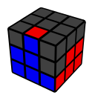
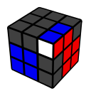
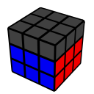
Solving the F2L
The basic approach is to “pair” a corner + edge then “insert” them into the appropriate “slot”
Step 2.1 – Temporarily “solve” the corner piece
Step 2.2 – “Pair” the corner + edge in the U-layer, ready for insertion
Step 2.3 – “Insert” the F2L pair into the appropriate “slot”

Slide 5
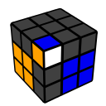
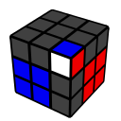
Step 2.1 – Solving the Corner
A corner can be “solved” using the right-handed trigger U R U’ R’ or the left-handed mirror U’ L’ U L
Setup: Ensure the sticker matching the cross color is facing front before executing the trigger
Execution: Turn the U-layer with your index finger(s)
U’ L’ U L
U R U’ R’

Slide 6
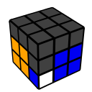
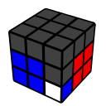
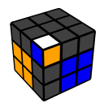
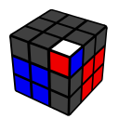
Step 2.1 – Tricky Corners
U’ L’ U L * 2
U R U’ R’ * 2
U’ L’ U L * 3
U R U’ R’ * 3

Slide 7
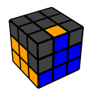
Step 2.2 – Pairing the Edge + Corner
The same triggers can be used to “pair” an edge with its corner
Setup: Ensure the edge sticker matches the front center before executing the trigger
Execution: Turn the U-layer with your index finger(s)
U’ L’ U L
U R U’ R’

Slide 8
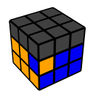
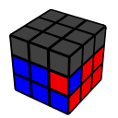
Step 2.2 – Tricky EDGES
If the edge is already in the correct slot but “badly oriented” the pair needs to be extracted and re-solved
“Extract” the corner and edge pieces using the standard trigger(s) – see below
Rotate the cube and “solve” the corner – i.e. step 2.1
Rotate the cube and “pair” the edge – i.e. step 2.2
U’ L’ U L …
U R U’ R’ …

Slide 9
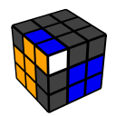
Step 2.3 – Inserting the F2L Pair
Insert an F2L pair as you would solve a corner in step 2.1
Setup: Ensure the sticker matching the cross color is facing front before executing the trigger
Execution: Turn the U-layer with your index finger(s)
U’ L’ U L
U R U’ R’

Slide 10
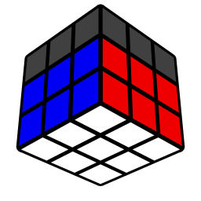

Solve the Remaining Pairs!

